Slide 1







CSCI6364: MACHINE LEARNING
BIG SALES PREDICTION USING RANDOM FOREST REGRESSOR
SRAVANI.B
G280598024

Slide 2





PROJECT INTRODUCTION
Analyzing sales data to predict future sales.
Significance: Accurate sales prediction is crucial for optimizing inventory, pricing, and marketing strategies in the retail industry.
Objective: Utilizing Random Forest Regressor to predict sales based on various features.

Slide 3



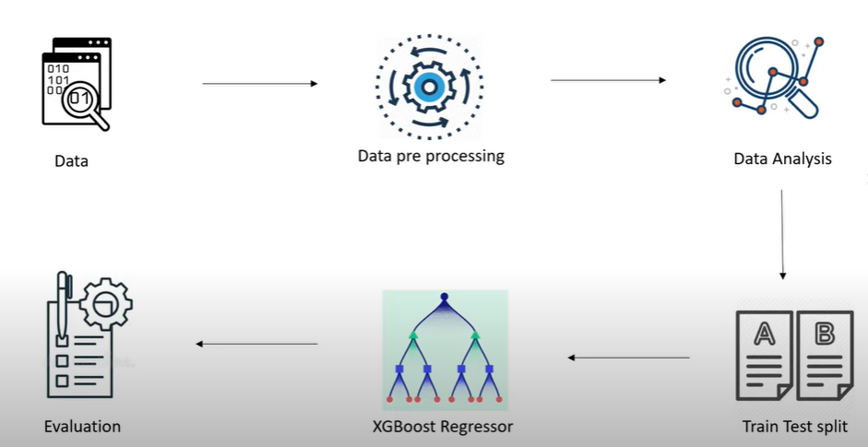

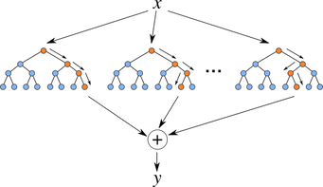
THE PLAN!!!

Slide 4

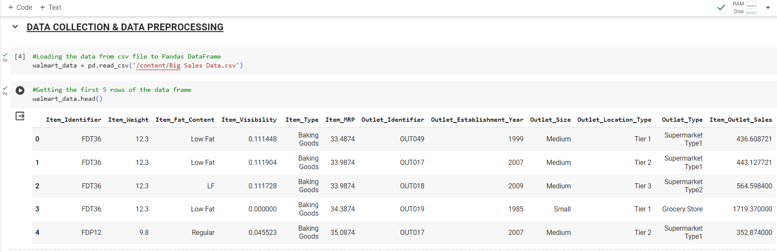

THE EXECUTION!!

Slide 5
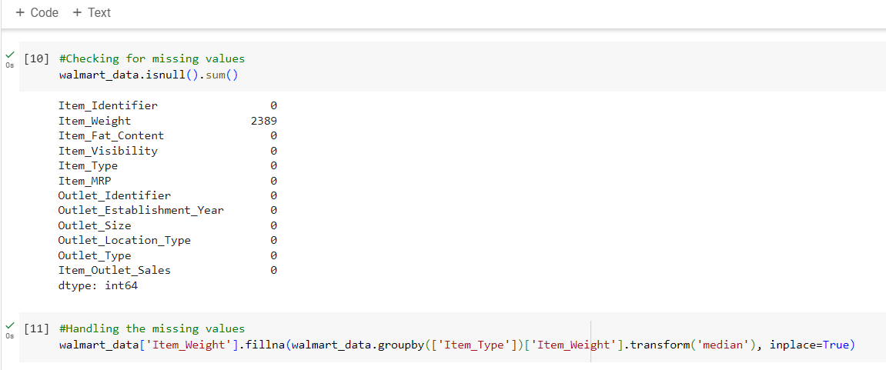
THE EXECUTION!!
CHECKING & Handling missing values

Slide 6
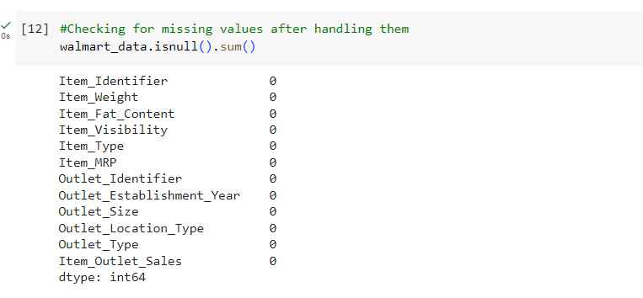
THE EXECUTION!!

Slide 7
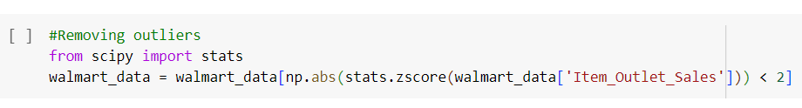
REMOVING OUTLIERS
Identified data points with Z-scores LESS than 2 and removed them

Slide 8
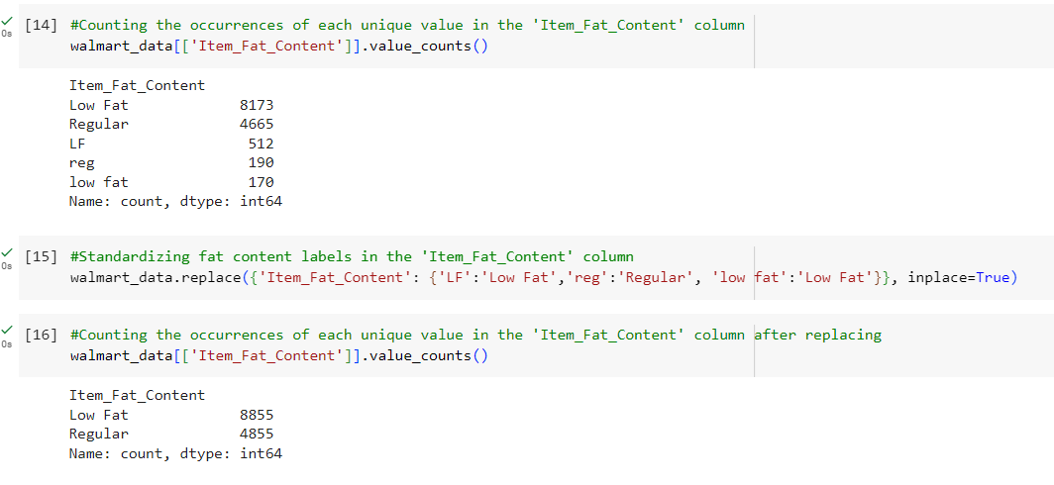
Get Categories and Counts of Categorical Variables

Slide 9
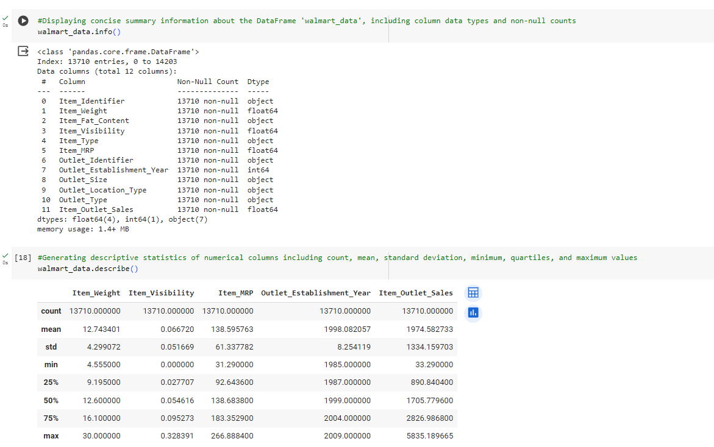
DATA ANALYSIS

Slide 10
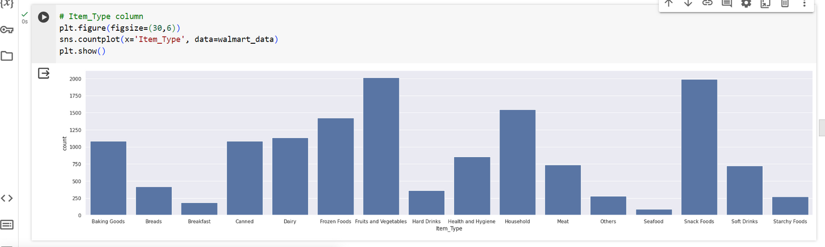
THE EXECUTION!!
DATA ANALYSIS

Slide 11
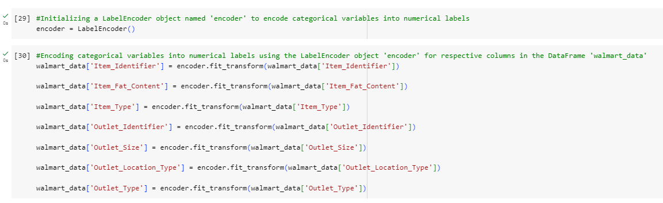
LABEL ENCODING

Slide 12
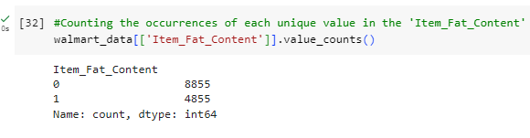
LABEL ENCODING

Slide 13
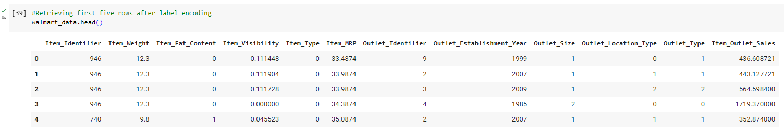
LABEL ENCODING

Slide 14
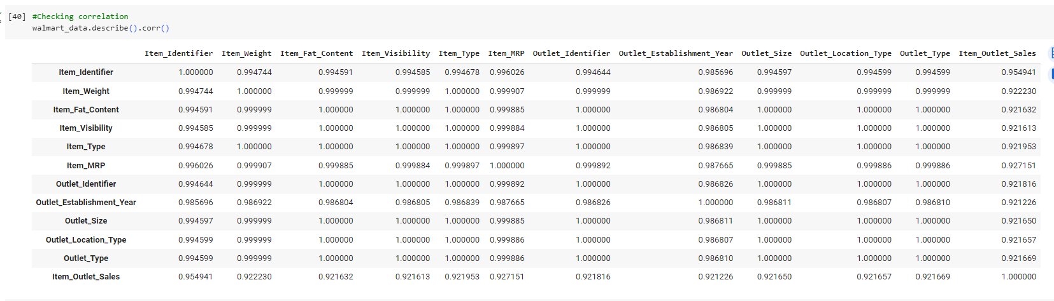
CORRELATION MATRIX

Slide 15
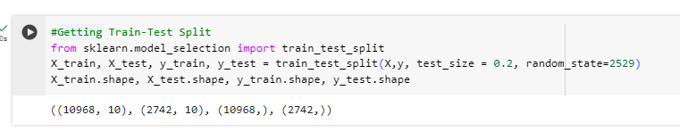
TRAIN TEST SPLIT
The dataset is split into training and testing sets to evaluate the performance of the model on unseen data.
Typically, a larger portion of the data is used for training (HERE, 80%), while the remaining portion is used for testing.

Slide 16
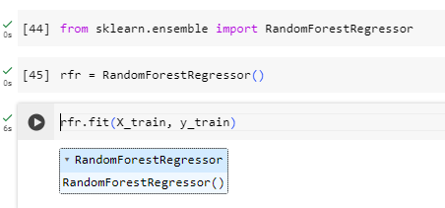
Model Training
The Random Forest Regressor is an ensemble learning technique that builds multiple decision trees and combines their predictions to improve accuracy.
It is well-suited for regression tasks such as sales prediction, where the target variable is continuous.

Slide 17
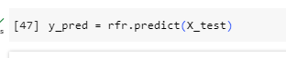
MODEL PREDICTION
After training the Random Forest Regressor model on the training data, we proceed to make predictions on the test dataset.
The model predicts the sales figures for each observation in the test dataset based on the values of features such as item weight, visibility, MRP, outlet type, etc.

Slide 18
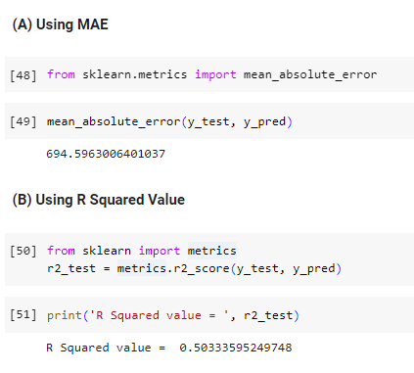
MODEL EVALUATION
Mean Absolute Error (MAE) measures the average absolute difference between the predicted and actual values.
R Squared Value (R^2) represents the proportion of the variance in the dependent variable that is predictable from the independent variables.

Slide 19
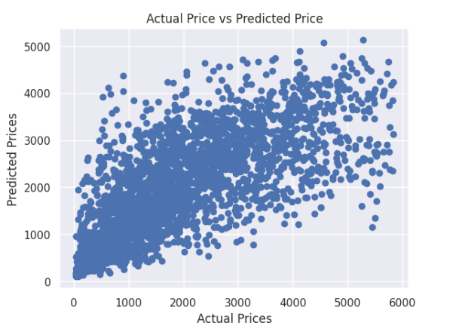
VISUALIZATION OF ACTUAL VS. PREDICTED VALUES

Slide 20
CONCLUSION
Accurate sales prediction is essential for retail optimization.
The Random Forest model shows promising performance.
Insights from data analysis provide valuable trends.
Model predictions closely match actual sales.
Predictive analytics aid in strategic decision-making.
Continuous model refinement enhances predictive accuracy.

Slide 21


I’M DONE PREDICTING SALES..
BYE BYE!!

